Slide 1
Hybrid-Learning Algorithms for Generalized Periodic Signal Extrapolation
Josiah W. Smith

Slide 2
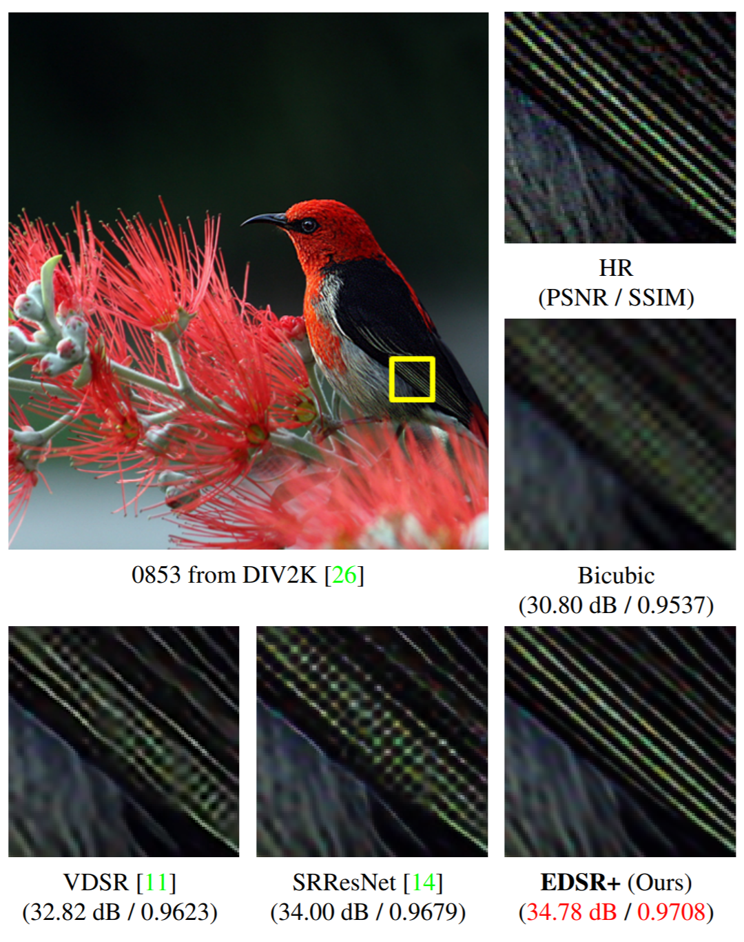
Motivation
Recent advances in deep learning have produced resolution upscaling, or “super-resolution,” for images with impressive results [1].
Here, the lines in the bird’s feather are resolved cleanly from a low-resolution image.
“HR” – ground truth (high resolution
“EDSR+” – proposed deep learning network solution

Slide 3
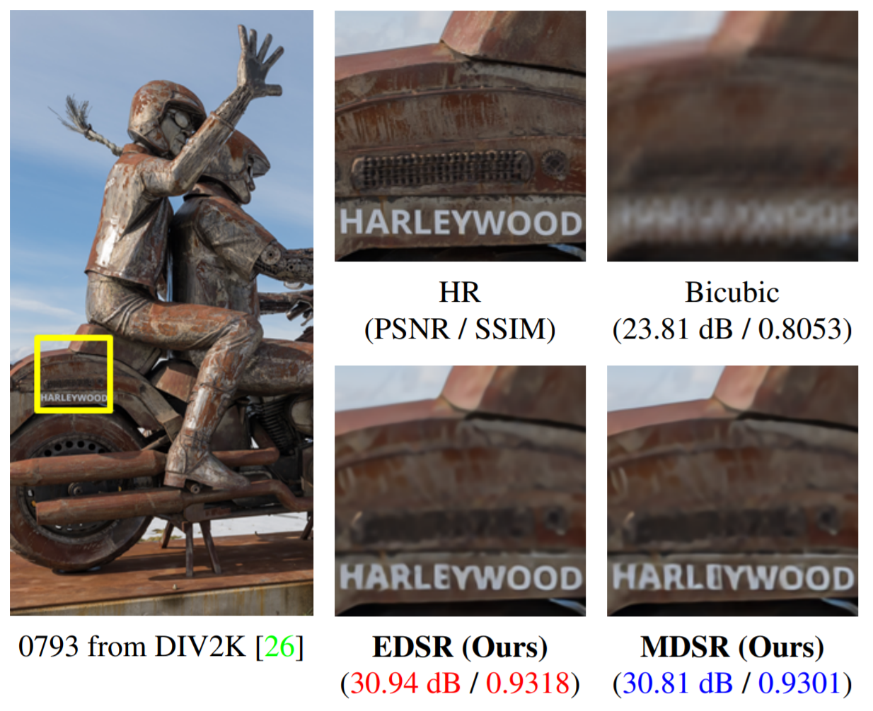
Motivation
Compared with bicubic upsampling, the words are much more visible with the EDSR method [1].
Hence, the deep learning algorithm is “adding” information because it is somehow aware of the “context” and interpolates in a meaningful way, given its “past experience.”

Slide 4
Motivation
Due to the sinc/time limited signal relationship, many problems seek to improve spectral resolution beyond the theoretical limit.
However, “image resolution” and “spectral resolution” are two entirely different terms.
Image resolution describes the number of well resolved pixels or image size.
Spectral resolution describes the ability to distinguish between two closely spaced frequency components.
Problem statements:
Can we adapt the existing deep learning super-resolution techniques to improve the spectral resolution of a signal?
In doing so, we effectively perform “signal extrapolation” in the time-domain. Can we leverage the known relationships between the two domains to improve performance?

Slide 5
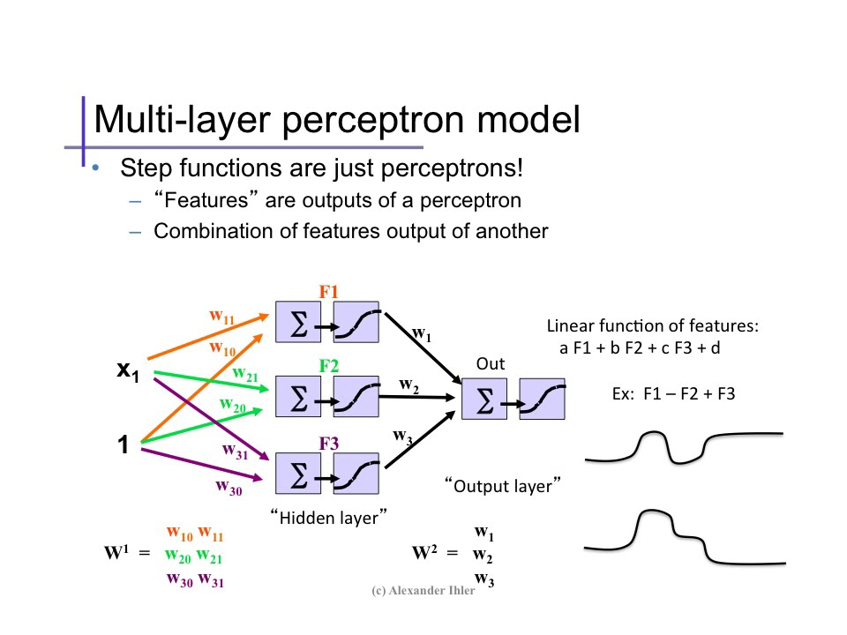
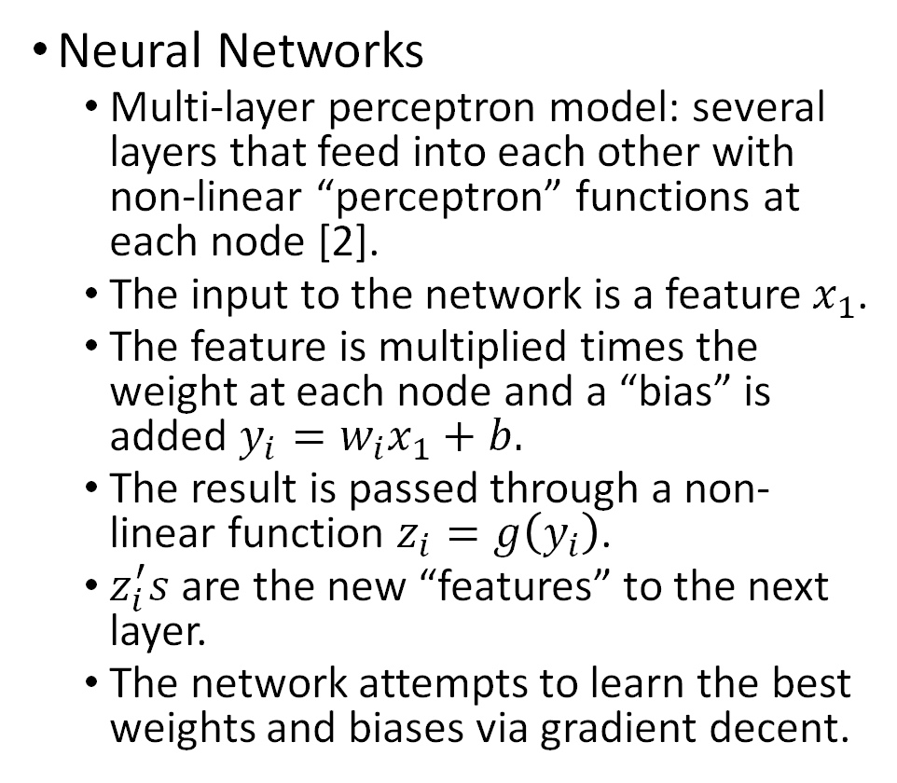
Background – Image Super-Resolution with CNNs
Neural Networks
Multi-layer perceptron model: several layers that feed into each other with non-linear “perceptron” functions at each node [2].
The input to the network is a feature $x_{1}$.
The feature is multiplied times the weight at each node and a “bias” is added $y_{i}=w_{i}x_{1}+b.$
The result is passed through a non-linear function $z_{i}=g\left(y_{i}\right)$.
$z_{i}^{′}s$ are the new “features” to the next layer.
The network attempts to learn the best weights and biases via gradient decent.

Slide 6
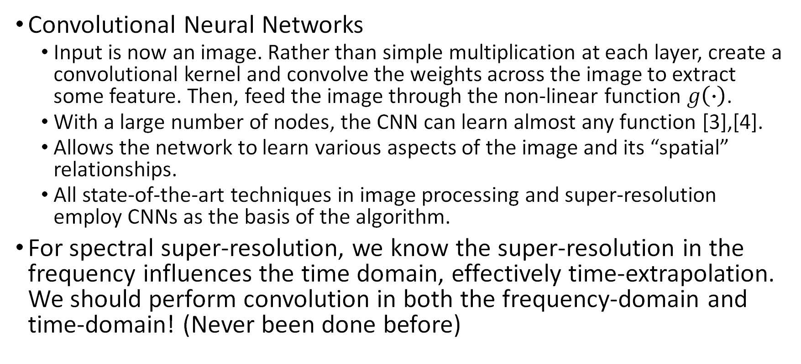
Background – Image Super-Resolution with CNNs
Convolutional Neural Networks
Input is now an image. Rather than simple multiplication at each layer, create a convolutional kernel and convolve the weights across the image to extract some feature. Then, feed the image through the non-linear function $g\left(∙\right)$.
With a large number of nodes, the CNN can learn almost any function [3],[4].
Allows the network to learn various aspects of the image and its “spatial” relationships.
All state-of-the-art techniques in image processing and super-resolution employ CNNs as the basis of the algorithm.
For spectral super-resolution, we know the super-resolution in the frequency influences the time domain, effectively time-extrapolation. We should perform convolution in both the frequency-domain and time-domain! (Never been done before)

Slide 7
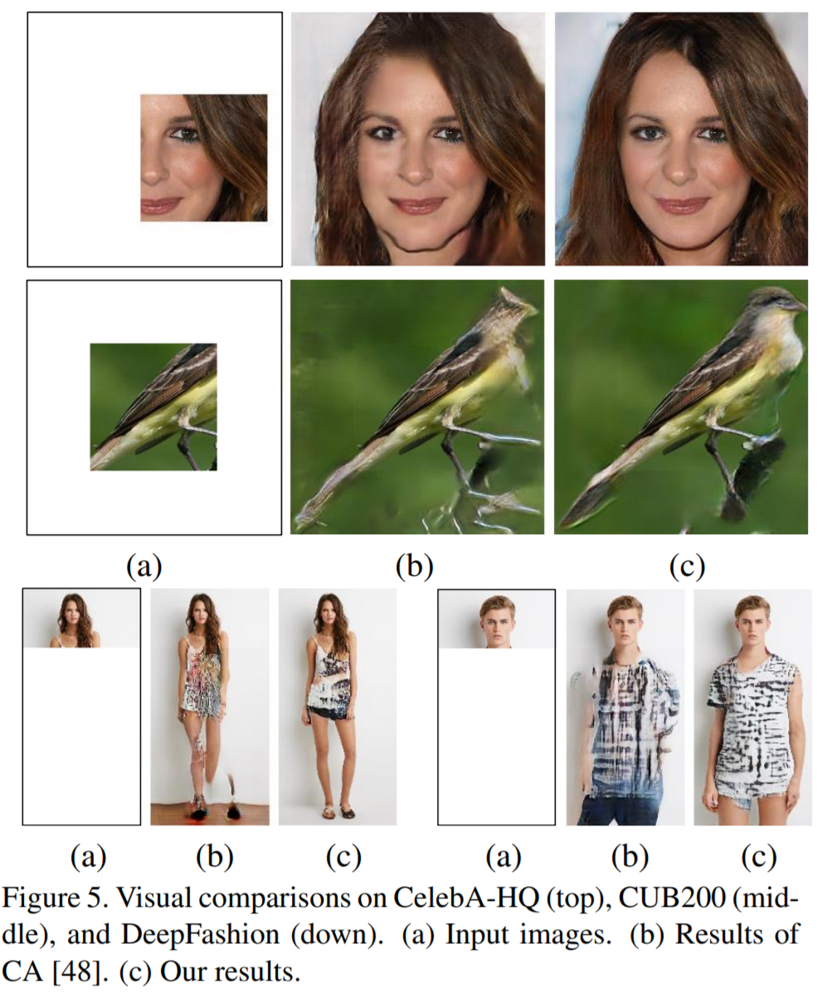
Background – Deep Learning Image Extrapolation
Several approaches have been taken using deep convolutional neural networks for so-called “image extrapolation,” where a partial image is provided, and the remainder of the image is generated [5],[6]. If these papers can add the head of a bird to the bird’s body, surely, we can extend a periodic signal.
We are considering a similar problem: extending/extrapolating a signal in the time domain. However, we have a large advantage: the inherently periodic nature of the signal. Since the signal is comprised of sinusoidal components, it is periodic and can be extrapolated more effectively than images as it is expected to follow specific, known patterns. We can further exploit our knowledge in the frequency-domain to aid the time-domain extrapolation.

Slide 8
Background – Previous or Similar Work
Several studies have investigated neural networks through the lens of Fourier analysis and established noteworthy conclusions.
“Spectral bias,” the tendency of CNNs to favor low frequency/smooth functions, is studied in [7]. Applied to the concept of hybrid-learning, this means we can expect the CNN to work well in the time-domain as many sinusoidal-based functions will exhibit smooth behavior.
In [8], the “Frequency Principle” is established concluding that CNNs fit target functions from low to high frequencies, opposite of most iterative methods.
Given the ability of the CNN to learn the low frequencies quickly, we propose an approach that seeks to improve spectral resolution by performing convolution in both the time-domain and frequency-domain.

Slide 9
Background – Previous or Similar Work
“Artificial Bandwidth Expansion” on speech signals is a common in the literature [9]-[11].
The time-domain speech signal is converted to time-frequency wavelet using spectrogram, or similar approach.
CNNs are often applied [9]-[11] in attempt to improve perceived bandwidth in the frequency domain.
However, the inherent relationships between the time-domain and frequency-domain are not explicitly exploited in the CNN. The CNN only operates on the wavelet treated it as an image.
In these papers, “bandwidth expansion” refers to artificially adding spectral information to the voice to mimic a full bandwidth audio signal.
In [12], a hybrid network is adopted with half of the network in the time-domain and half in the frequency-domain for improving MR image reconstruction.
Similar to what we propose, but less generalized. It is specific to 2-D MR k-domain data and its IFFT relationship to the image domain. We want to produce a very generalized algorithm that applies for almost any FFT-reliant problem.
Further, the complex-valued real/imaginary relationships are ignored in this paper.

Slide 10
Background – Previous and Similar Work
In [13], a complex-domain neural network is employed for “data extrapolation” and is used for MR imaging.
Mentions the relationship between truncation in time domain and spectral resolution.
Proposes a solution in the time-domain similar to an autoregressive approach but using neural networks. Does not use the newer CNN-based approaches or leverage the relationships between time and frequency.
Image Super-Resolution
A key component of [1] is the inclusion of “multi-scale” super-resolution, meaning upscaling by x2, x3, and x4 instead of “fixed-scale” where only one scale (x2) is implemented.
We can also incorporate this into our solution for additional novelty.

Slide 11
Proposed Solution
Artificially extend the length of the signal by improving the spectral resolution. Also, spectral resolution improvement alone has its own merit. Generalize for many problems and show elegant applications in radar and localization.
Goal is to maximize the impact of this work such that it could “blindly” improve spectral resolution for nearly any problem. Effectively a “better FFT” that can even retain phase coherence and duality unlike MUSIC, ESPIRIT, etc.
Since the solutions in [1] and many others are widely available and open-source, we adopt the existing techniques in deep learning and incorporate our understanding of signal theory for improved performance for spectral estimation.
Hence, we exploit our expertise in signal theory to improve the existing methods in deep learning: we call this field hybrid-learning algorithms.
Propose a network that alternates between time-domain and frequency-domain convolution while employing state-of-the-art deep learning techniques, e.g., residual learning [14].

Slide 12
Proposed Solution
Given the periodic nature of most signals we consider, there are very few problems in signal processing that are not solved in only one domain (time or frequency). Typically, we leverage knowledge of the signal in both the time-domain and frequency-domain (MUSIC is a good example of this). However, up until this point, when deep learning is applied to signal processing, it is only employed in one domain, either time or frequency.
We can be the first to innovate deep learning into the signal processing arena by more fully leveraging the time-frequency relationships and periodic composition of signals with the advances in deep learning. In this sense, we only add to the existing techniques with our prior expertise without needing to become experts in deep learning.

Slide 13

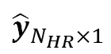
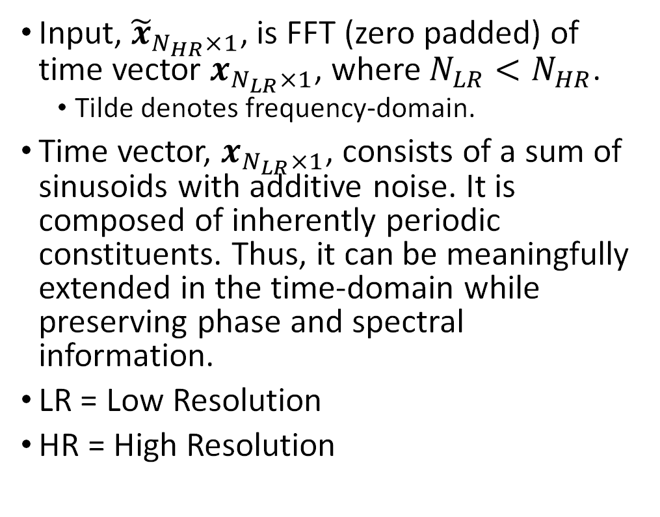
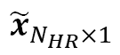
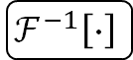
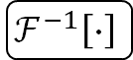
Proposed Deep Network
Input, ${\tilde{x}}_{N_{HR}×1}$, is FFT (zero padded) of time vector $x_{N_{LR}×1}$, where $N_{LR}<N_{HR}$.
Tilde denotes frequency-domain.
Time vector, $x_{N_{LR}×1}$, consists of a sum of sinusoids with additive noise. It is composed of inherently periodic constituents. Thus, it can be meaningfully extended in the time-domain while preserving phase and spectral information.
LR = Low Resolution
HR = High Resolution
$${\tilde{x}}_{N_{HR}×1}$$
Convolution in Frequency Domain
$$ℱ^{−1}\left[∙\right]$$
Convolution in Time Domain
$$ℱ\left[∙\right]$$
Convolution in Frequency Domain
$$ℱ^{−1}\left[∙\right]$$
Convolution in Time Domain
$${\hat{y}}_{N_{HR}×1}$$

Slide 14
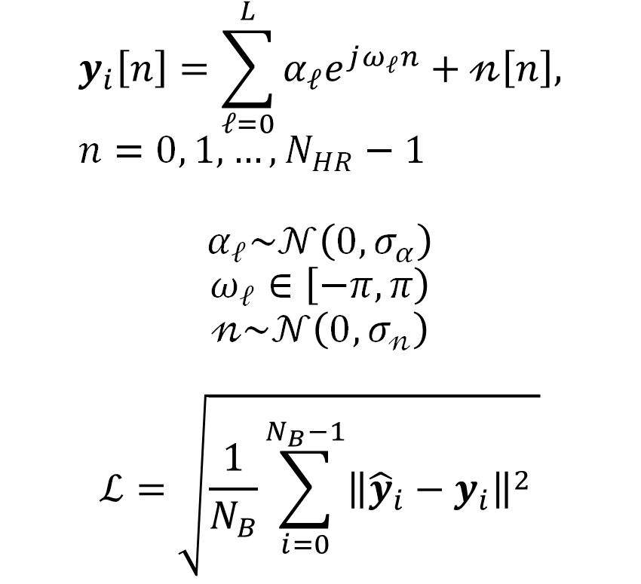
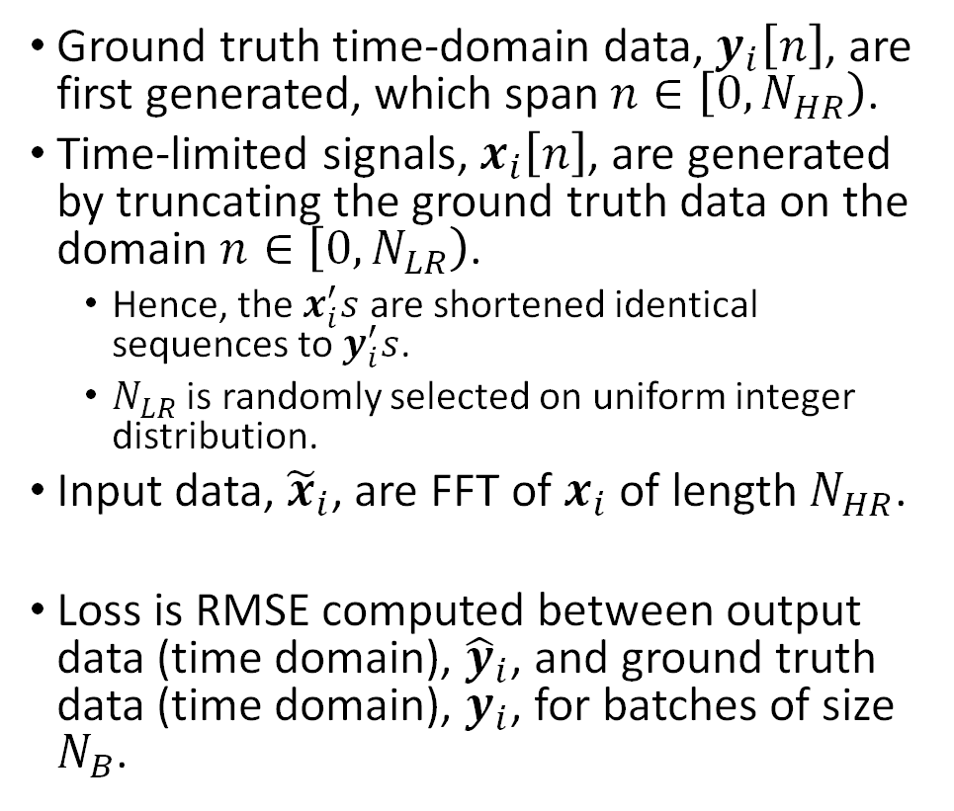
Training Data and Loss
Ground truth time-domain data, $y_{i}\left[n\right]$, are first generated, which span $n∈\left[0, N_{HR}\right)$.
Time-limited signals, $x_{i}\left[n\right]$, are generated by truncating the ground truth data on the domain $n∈\left[0, N_{LR}\right)$.
Hence, the $x_{i}^{′}s$ are shortened identical sequences to $y_{i}^{′}s$.
$N_{LR}$ is randomly selected on uniform integer distribution.
Input data, ${\tilde{x}}_{i}$, are FFT of $x_{i}$ of length $N_{HR}$.
Loss is RMSE computed between output data (time domain), ${\hat{y}}_{i}$, and ground truth data (time domain), $y_{i}$, for batches of size $N_{B}$.
$$y_{i}\left[n\right]=\sum_{𝓁=0}^{L}{α_{ℓ}e^{jω_{ℓ}n}}+𝓃\left[n\right], n=0, 1, …, N_{HR}−1$$
$$α_{ℓ}\sim 𝒩\left(0, σ_{α}\right)$$
$$ω_{ℓ}∈\left[−π, π\right)$$
$$𝓃\sim 𝒩\left(0, σ_{𝓃}\right)$$
$$ℒ=\sqrt{\frac{1}{N_{B}}\sum_{i=0}^{N_{B}−1}{{\left\|{\hat{y}}_{i}−y_{i}\right\|}^{2}} }$$

Slide 15
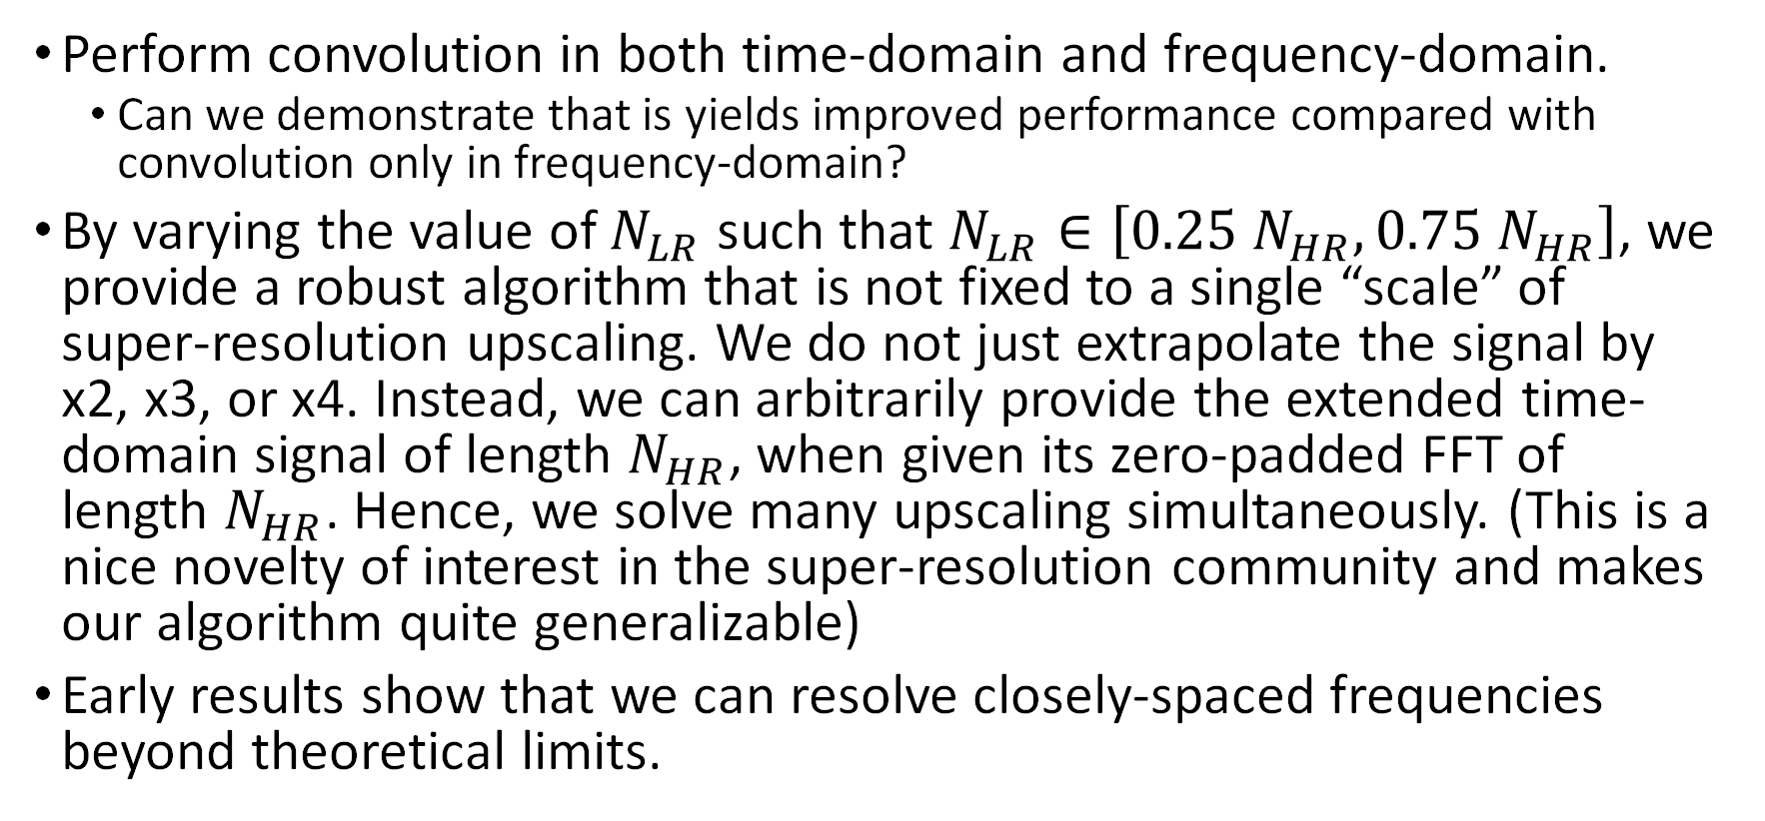
Key Points
Perform convolution in both time-domain and frequency-domain.
Can we demonstrate that is yields improved performance compared with convolution only in frequency-domain?
By varying the value of $N_{LR}$ such that $N_{LR}∈\left[0.25 N_{HR}, 0.75 N_{HR}\right]$, we provide a robust algorithm that is not fixed to a single “scale” of super-resolution upscaling. We do not just extrapolate the signal by x2, x3, or x4. Instead, we can arbitrarily provide the extended time-domain signal of length $N_{HR}$, when given its zero-padded FFT of length $N_{HR}$. Hence, we solve many upscaling simultaneously. (This is a nice novelty of interest in the super-resolution community and makes our algorithm quite generalizable)
Early results show that we can resolve closely-spaced frequencies beyond theoretical limits.

Slide 16
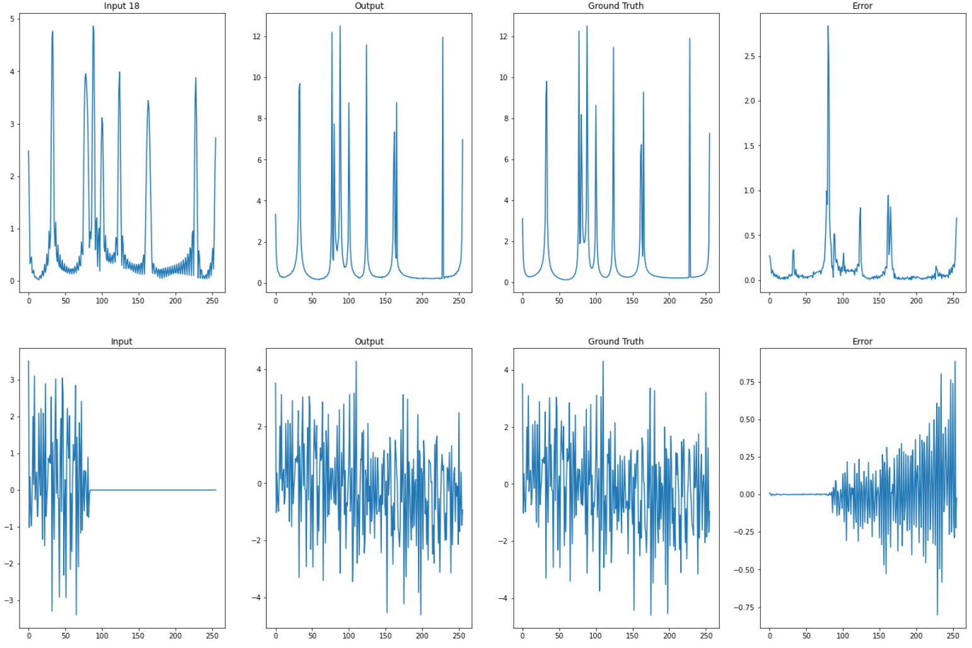
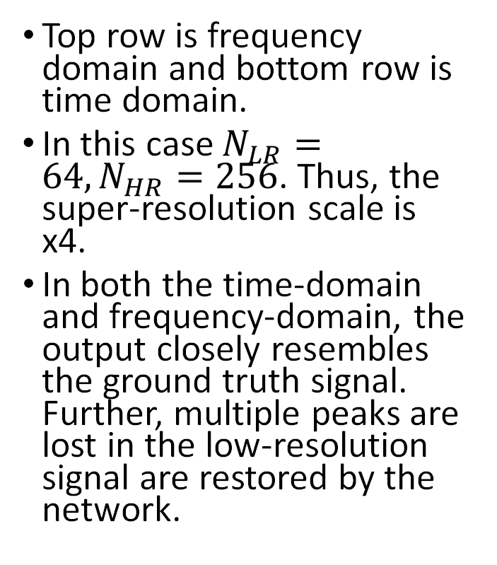
Results – Time Domain
Input to network
Top row is frequency domain and bottom row is time domain.
In this case $N_{LR}=64, N_{HR}=256$. Thus, the super-resolution scale is x4.
In both the time-domain and frequency-domain, the output closely resembles the ground truth signal. Further, multiple peaks are lost in the low-resolution signal are restored by the network.
Frequency Domain
Time Domain
Output from network

Slide 17
Results – Time Domain
Frequency Domain
Frequency Domain
Time Domain
Closely spaced frequencies are resolved in the output signal that were lost in the input signal due to the sinc-effect.

Slide 18
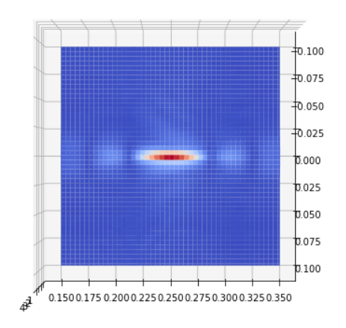
Results – SAR Imaging
1-D scanning 2-D image reconstruction SAR imaging scenario.
Single ideal point target
Recovered image:

Slide 19
Results – SAR Imaging – Important Note
Contrary to the FTRC project, we are not feeding the radar image into the deep learning network. Rather, we feed each radar beat signal into the network for “bandwidth extrapolation.” The time domain are our k-domain samples for FMCW radar. We are feeding these k-domain samples into the network and the output is a “time-extended” version of the input signal. Hence, we are artificially increasing the bandwidth.
Thus, our network is extremely generalizable. For any problem involving an FFT of a signal consisting of a sum of sinusoids where spectral resolution is important while preserving phase information, our proposed algorithm gives a better spectral resolution and effectively “extrapolates” the time-domain signal. This can be used for communications, BLE ranging, radar, etc. It is not limited to a specific problem, but acts as effectively a “better FFT.”

Slide 20
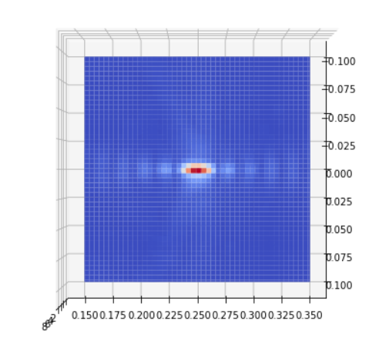
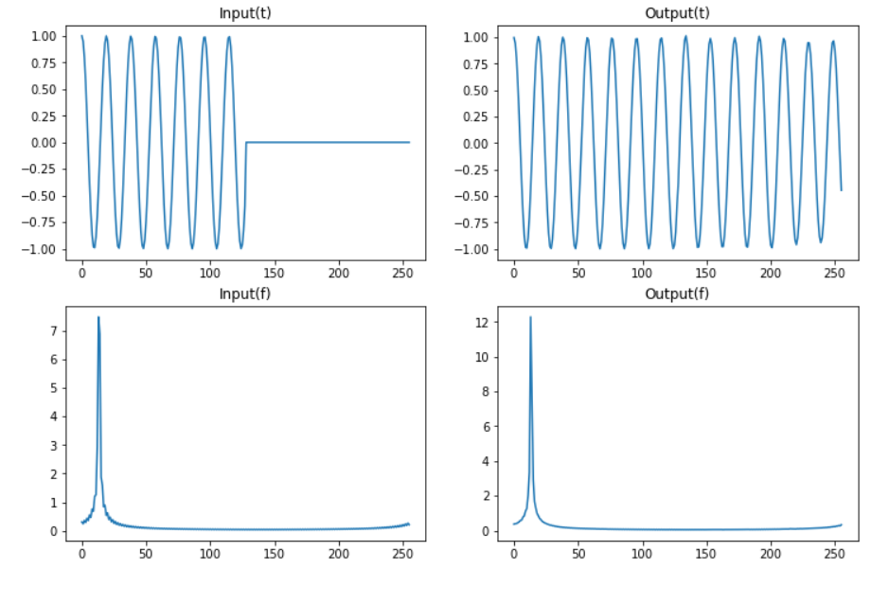
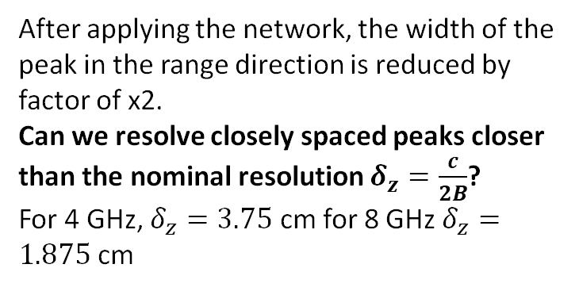
Results – SAR Imaging
Raw
After Network
Time domain is extrapolated while maintaining phase coherency and spectral width is reduced
- “Bandwidth extrapolation” is performed on the radar signal giving effectively 8 GHz
y (m)
y (m)
z (m)
z (m)
After applying the network, the width of the peak in the range direction is reduced by factor of x2.
Can we resolve closely spaced peaks closer than the nominal resolution $δ_{z}=\frac{c}{2B}$?
For 4 GHz, $δ_{z}=3.75$ cm for 8 GHz $δ_{z}=1.875$ cm

Slide 21
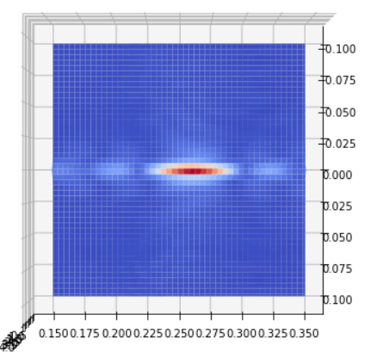
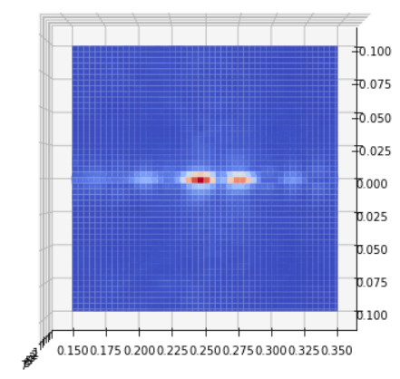
Results – SAR Imaging Resolution Improvement
Raw Radar Image
Radar Image Recovered after “Signal Extrapolation”
Two points spaced by 2.14 cm, the range resolution achieved by B = 7 GHz.
Attempted at range resolution for 8 GHz bandwidth without success.
The network is able to extrapolate the signal, but it is not perfect.

Slide 22
Unanswered Questions
Do we have the optimal network configuration?
We can try alternatives such as add/remove layers (complexity), change sizes of convolution filters depending on time/frequency domain, compute loss only over the portion of the data that is extrapolated.
Still room for improvement for very closely spaced frequencies.
Are there additional ways we can leverage our expertise in signal theory to improve the network architecture?
We need to exploit our domain specific knowledge for solving this problem in the most robust manner.
Should we also train our network to denoise the additive noise?
In [14], a CNN is used to remove AWGN noise from time-domain data improving SNR and subsequent spectral estimation using MUSIC. We could do something similar by training with noiseless ground truth data.

Slide 23
Conclusions
Although “resolution” is defined differently for images and spectra, spectral super-resolution, whose Fourier dual is time-domain extrapolation, can be effectively implemented using a deep convolutional neural network architecture similar to those adopted by state-of-the-art image super-resolution papers [1].
We improve the CNN architecture by employing convolution in both the time-domain and frequency-domain.
The resulting algorithm demonstrates ability to blindly extend any sinudoidal signal in the time-domain and improves its spectral resolution.
For many applications improving spectral resolution can provide crucial performance gain such as spatial resolution (SAR imaging), channel capacity, reduce OFDM channel width, DoA estimation resolution, etc.

Slide 24
Conclusions
Innovation: This work could be a cardinal paper in a new domain of signal processing: hybrid-learning algorithms. We are the first to employ “cross-domain” convolution to leverage the known Fourier relationships when applying deep learning to signal processing problems. This hybrid classical/modern machine learning approach could result in many enormous steps forward for signal processing as a whole.
Urgency: We need to get ahead of others in this area, even if our work is not perfected. Granted, there are many options to explore and opportunities to compare nearly endless combinations/approaches for this problem. However, we want to be the first to publish in this domain. We will have time to improve our methods, but we should be the first to establish the base-line and take credit for this innovation.

Slide 25
Conclusions
Venue: I think it is in our best interest to pursue the most visibility for this work. Ideally, I think this work is a good fit for a deep learning conference such as IEEE CVPR (computer vision and pattern recognition) as we are enabling enhanced computer vision by exploiting pattern recognition and deep learning techniques. All of the top papers in image super-resolution are published in this venue and it is the top deep learning conference. This will give us the best exposure and invite many opportunities if we are accepted. Its due date will be in Nov. 2021. Otherwise, we could consider an IEEE letters journal since we want to publish this work and get ahead of others on these topics.

Slide 26
References
[1] https://arxiv.org/pdf/1707.02921v1.pdf
[2] https://www.youtube.com/watch?v=bH6VnezBZfI
[3] https://arxiv.org/pdf/1709.02540.pdf
[4] http://neuralnetworksanddeeplearning.com/chap4.html
[5] https://jiaya.me/papers/imgextrapolation_cvpr19.pdf
[6] https://arxiv.org/pdf/1808.07757.pdf
[7] https://arxiv.org/pdf/1806.08734.pdf
[8] https://arxiv.org/pdf/1901.06523.pdf
[9] https://ieeexplore.ieee.org/document/7602894

Slide 27
References
[10] https://ieeexplore.ieee.org/document/8063328
[11] https://ieeexplore.ieee.org/document/8270683
[12] https://arxiv.org/pdf/1810.12473v1.pdf
[13] https://ieeexplore.ieee.org/document/554457
[14] https://ieeexplore.ieee.org/document/8822737

